Slide 1

Problem Statement & Objectives
AUTOMATED KUBERNETES NETWORK SELF-HEALING
THE PROBLEM
THE OBJECTIVE
Design and implement a closed-loop, zero-touch self-healing system for Kubernetes network infrastructure.
Silent Failures
DNS outages, misconfigured policies, or CNI crashes occur without pod termination, bypassing standard K8s health checks.
KEY GOALS
Manual Bottleneck
01
Active Detection: Continuously verify DNS resolution & cross-namespace connectivity.
Traditional monitoring relies on human operators, leading to high MTTR and prolonged service downtime.
02
Automated Remediation: Programmatically resolve faults without human intervention.
03
Real-time Observability: Visualize the failure-and-recovery lifecycle in real-time.
K8S-AUTO-HEAL // EVALUATION
01
Notes:
Good morning/afternoon. Our project focuses on making Kubernetes networks more resilient. In modern microservices, network issues like accidental policy blocks or DNS failures cause silent outages. Usually, an alert wakes up an engineer who manually fixes it, taking precious time. Our objective was to build an intelligent, automated closed-loop system that not only detects these failures in real-time but uses a custom Operator to automatically fix them, reducing downtime from minutes or hours to just seconds.

Slide 2
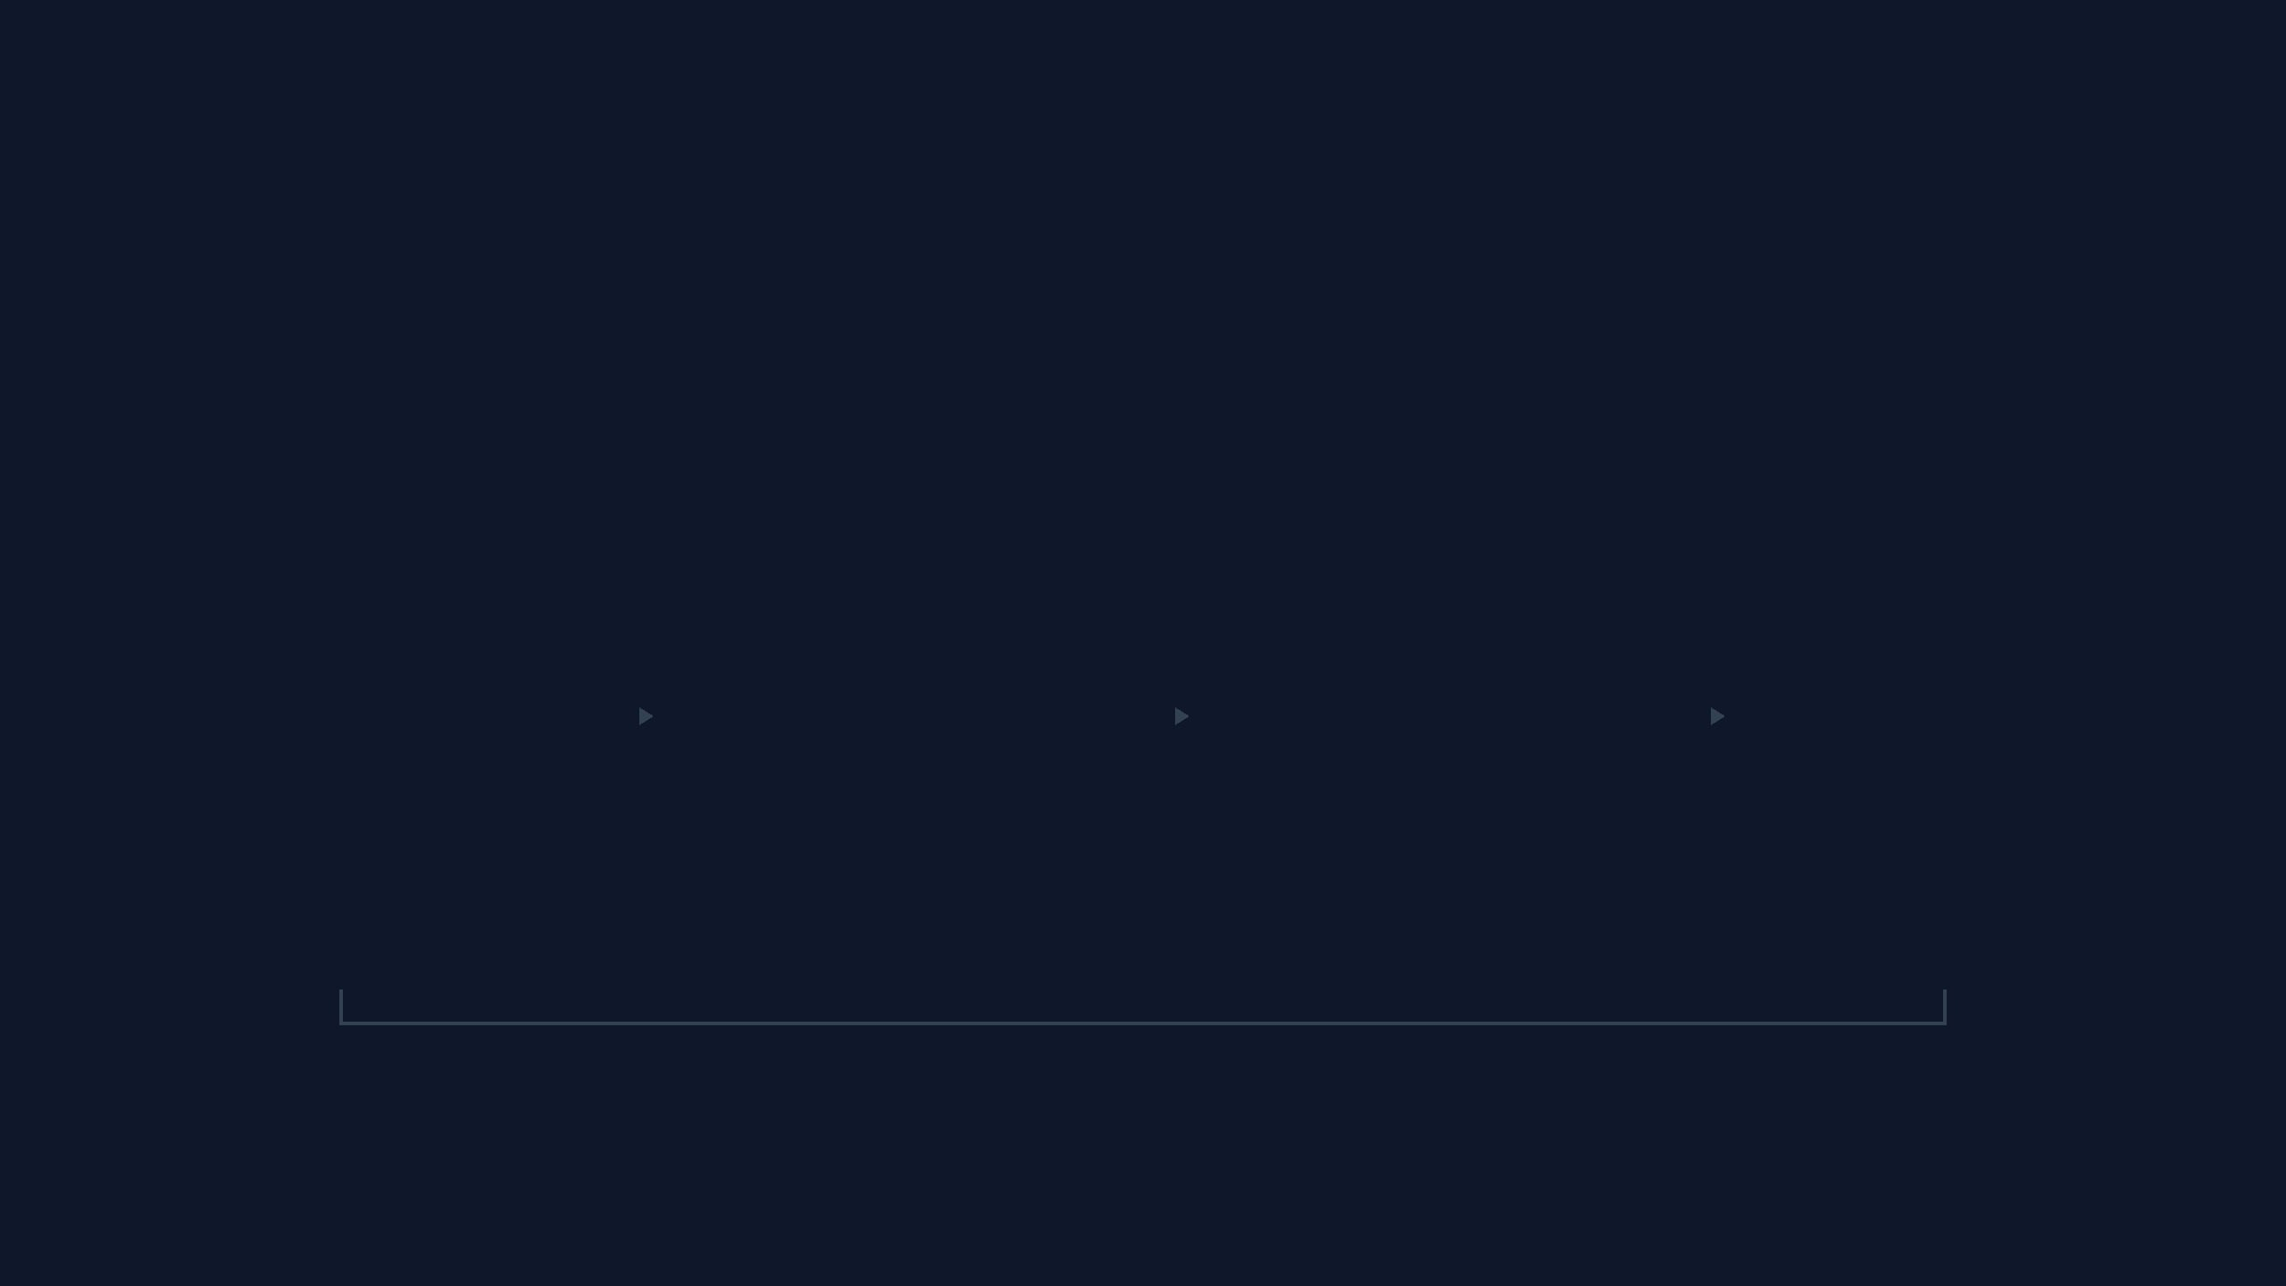
4-Layer Self-Healing Architecture
SYSTEM DESIGN & MECHANISM OVERVIEW
LAYER 1
LAYER 2
LAYER 3
LAYER 4
Infrastructure
Active Detection
Decision Engine
Remediation
CoreDNS Pods
dns-probe
Prometheus
Go Operator
Network Policies
connectivity-probe
Alertmanager
Calico CNI
CONTINUOUS POLLING & STATE CONVERGENCE
K8S-AUTO-HEAL // EVALUATION
02
Notes:
Our architecture is divided into four stages: Workloads, Detection, Decision, and Remediation. We built custom Python probes that constantly test DNS and HTTP connectivity across namespaces. When a failure occurs, Prometheus detects the metric drop and Alertmanager fires a webhook. The brain of our project is a custom Operator written in Go. It catches this webhook, identifies the exact nature of the fault, and uses K8s API calls to immediately correct the infrastructure—for example, wiping out a bad network policy.

Slide 3
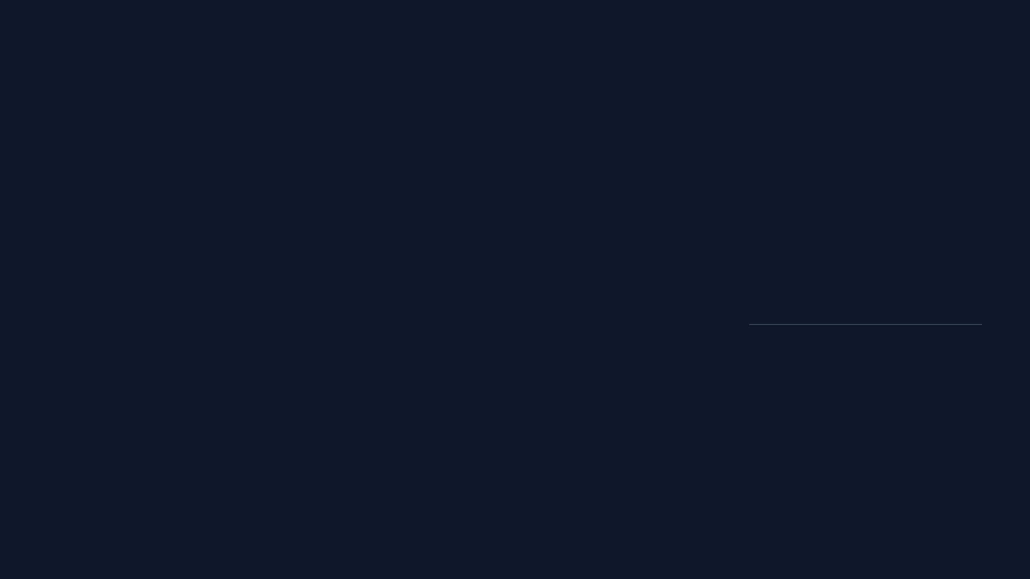
What We Built, Fixed & Evaluated
EXTENSIONS, CRITICAL ISSUES & CLOSED-LOOP RESULTS
KEY IMPLEMENTATIONS & EXTENSIONS
CRITICAL ISSUES FIXED
EVALUATION & RESULTS
Custom Kubernetes Operator
Network Policy Additivity
01
DROP
Fault injection
Go-based controller interacting directly with the Kubernetes API to execute automated remediation logic.
Operator strips conflicting baseline “allow” rules before applying targeted fixes, solving additive policy stacking.
02
ALERT
Prometheus / AM
Active Probing System
03
HEAL
Go Operator
Python exporters, dns-probe and connectivity-probe, continuously validate cluster network health.
Metric Tracking Accuracy
Using kill 1 inside containers simulates true runtime crashes for accurate Kube-State-Metrics tracking.
04
RECOVER
Healthy state
Chaos Engineering Framework
Fault-injection pipeline simulates CNI crashes, blocking NetworkPolicies, and DNS death.
✓ CLOSED-LOOP SUCCESS
Injected faults are detected, remediated, and returned to green without human intervention.
Observability Pipeline
Prometheus, Alertmanager, and Grafana tuned for network self-healing visualization.
K8S-AUTO-HEAL // EVALUATION
03
Notes:
On top of standard Kubernetes, we built several critical extensions. We wrote a custom Go Operator to act as the brain, Python probes for active monitoring, and a chaos engineering framework to test the system with real faults. During development, we fixed complex bugs like Kubernetes Network Policies stacking unexpectedly, and adjusted our fault simulation to use container kills so metrics were tracked accurately. Ultimately, evaluating the system showed complete closed-loop success—if we inject a fault, Grafana turns red, the operator automatically heals the infrastructure, and the dashboard recovers to green within a minute.

Slide 4
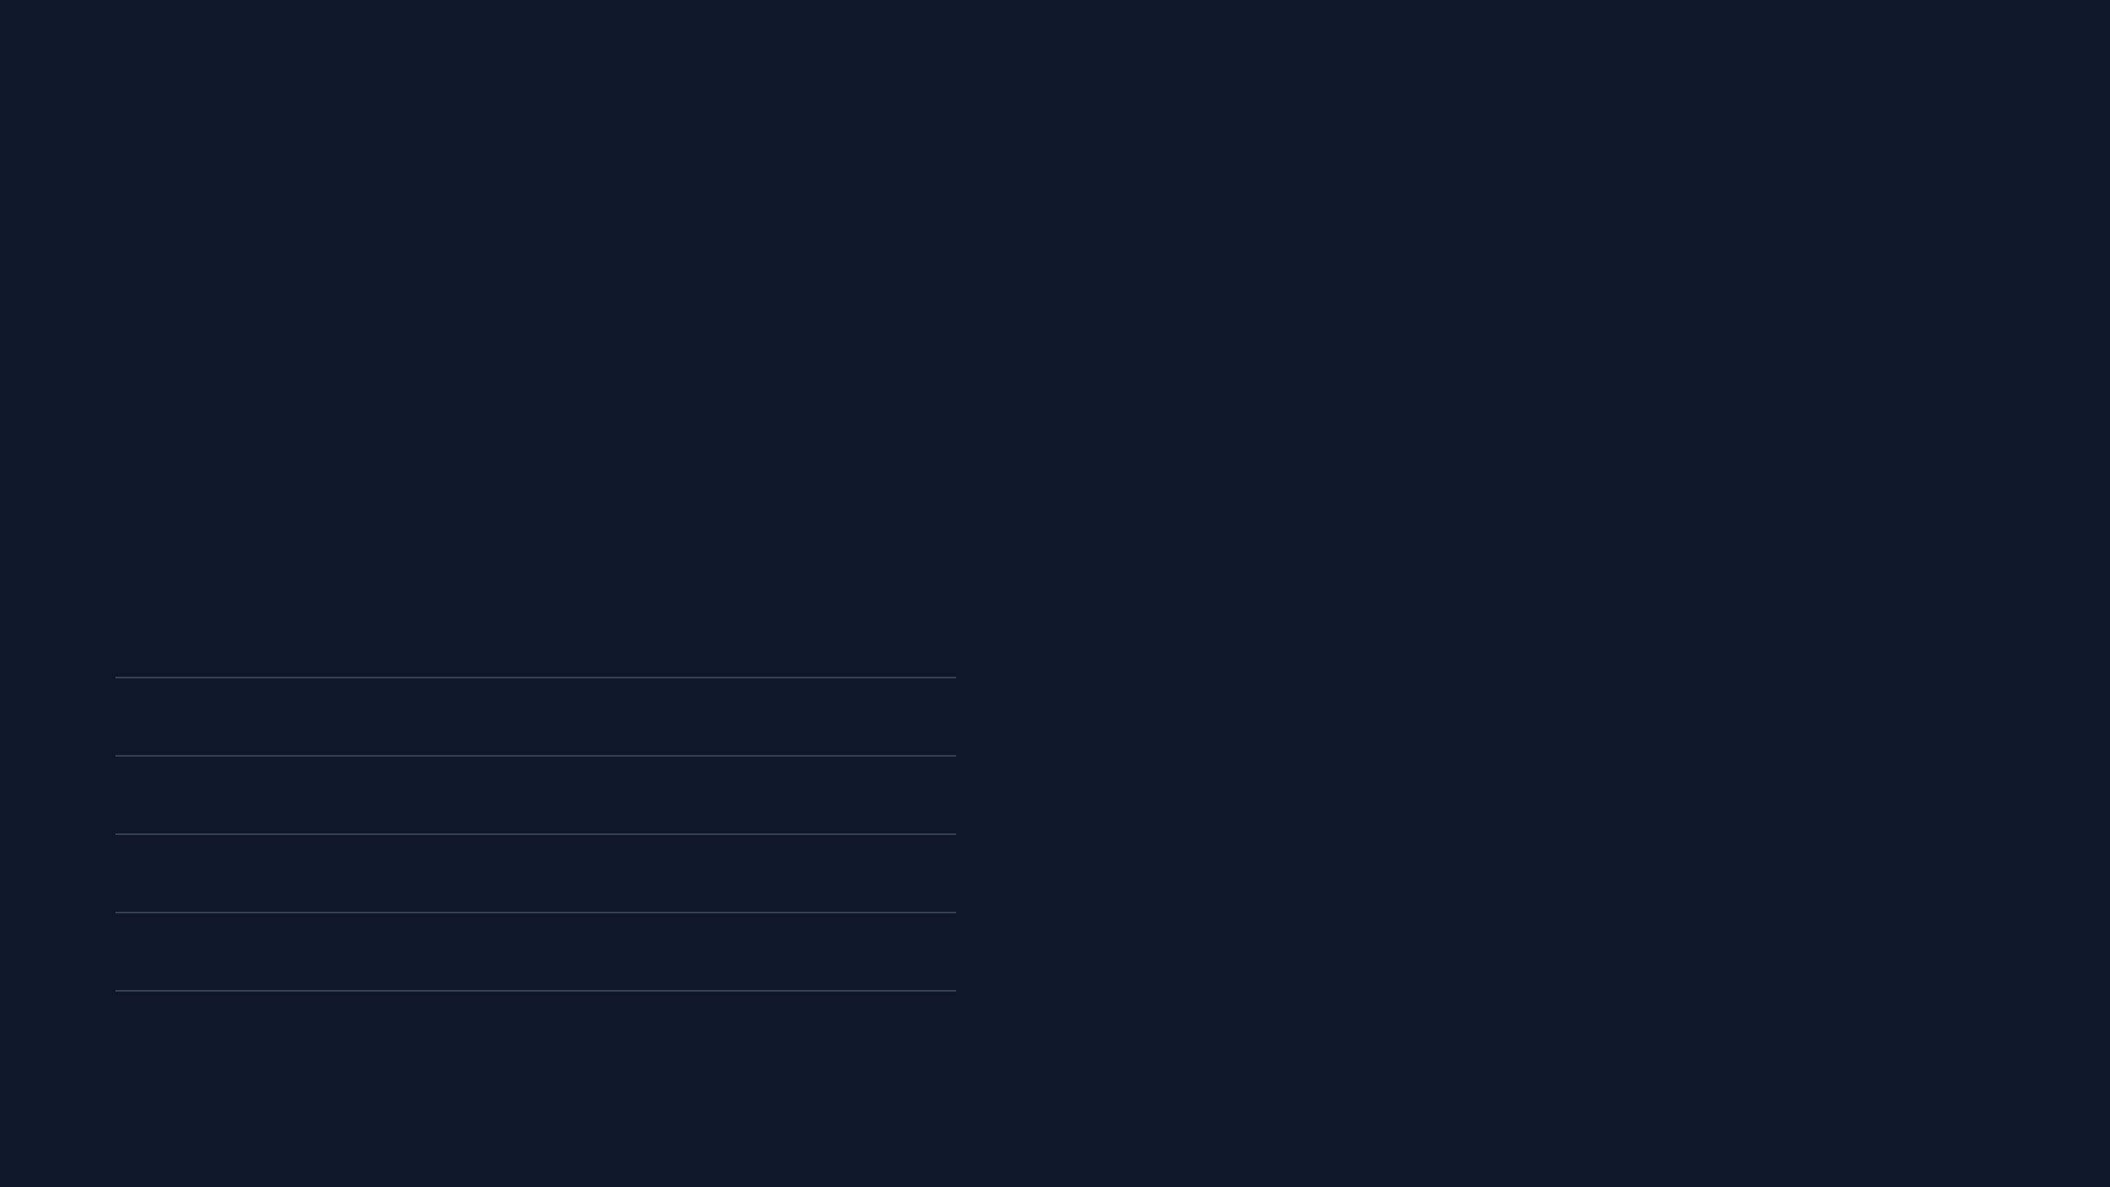
Performance, Scalability & Reliability
SELF-HEALING SLA & SYSTEM ROBUSTNESS
PERFORMANCE (SELF-HEALING SLA)
RELIABILITY & SCALABILITY
~60s
IDEMPOTENCY
RBAC SECURITY
Standard client-go libraries ensure operations are safe to run multiple times without corruption.
Strict least-privilege scoping via dedicated ClusterRoles and ServiceAccounts.
Detection to Remediation Loop
Probe Interval
15s
STATELESSNESS
METRIC EFFICIENCY
Prometheus "For" State
15s
Go-webhook receiver holds no local state, allowing horizontal scaling across large clusters.
Lightweight probes conform to standard K8s formats, preventing Prometheus overhead.
Alertmanager Grouping
10s
Operator Execution
10s
State Convergence
10s
K8S-AUTO-HEAL // EVALUATION
04
Notes:
For non-functional testing, our primary metric is the Service Level Agreement (SLA) for automated recovery. Our system completes the entire loop—from the moment a fault happens to the K8s cluster returning to a healthy state—in about 60 seconds. We tuned Prometheus and Alertmanager intervals specifically for this aggressive SLA. Furthermore, we designed the Go Operator to be stateless and idempotent, meaning it won't crash or corrupt the K8s database even if multiple alerts fire simultaneously. It is also strictly secured using K8s Role-Based Access Control.

Slide 5
Technical Challenges & Learnings
INSIGHTS FROM BUILDING RESILIENT INFRASTRUCTURE
⚠
⚡
⚙
Monitoring "Chicken-or-Egg"
Event-Driven Concurrency
Simulating True Outages
DNS failure broke internal K8s resolution, causing Grafana to lose connection to Prometheus.
Alertmanager fired multiple webhooks for one incident before the cluster fully healed.
Standard pod deletions reset restart counters, masking the true nature of runtime crashes.
LEARNING
Decouple monitoring from the infrastructure it monitors using IP-based routing.
LEARNING
LEARNING
Implement state-aware logic in the Operator to check API state before acting.
Use "kill 1" inside containers to simulate crashes that Kube-State-Metrics can track.
K8S-AUTO-HEAL // EVALUATION
05
Notes:
The biggest challenge we faced was the 'Chicken-or-Egg' monitoring problem. We designed a fault that takes down the cluster's DNS. However, when we did this, Grafana completely broke because it used that exact same K8s DNS to find Prometheus! It taught us a vital lesson about decoupling monitoring infrastructure from the application infrastructure. We also faced challenges with event concurrency—Alertmanager firing multiple alerts while the fix was already in progress—which forced us to make our Go operator much smarter and state-aware. Overall, these challenges provided deep insights into Kubernetes internals.

